Slide 1
Get started with
Microsoft 365 Copilot in Teams
Practical examples and how-tos for licensed Microsoft 365 Copilot users
September 2025

Slide 2

Overview
Microsoft 365 Copilot is your everyday AI companion. Copilot is available in Teams Meetings as a private experience, helping you summarize the meeting, untangle unresolved perspectives, and more.
For more prompt ideas, visit Use Copilot in Microsoft Teams meetings - Microsoft Support.

Slide 3
How it works

Slide 4
How it works
During a meeting, Copilot relies on speech-to-text (STT) technology to analyze what was said when responding to user prompts. STT must be active in order to use Copilot during the meeting. To use Copilot after the meeting, there must be a transcript (a record of all spoken utterances processed through STT). Your IT admin determines if you have the ability to start transcript, use STT only during the meeting for Copilot, or if you cannot use STT for Copilot at all.
The “Allow Copilot” Meeting Option gives meeting organizers control over the availability of Copilot in their meetings. You can find the “Allow Copilot” option under “Record and Transcribe” section of meeting options. Your admin determines the default value for this option.
“Allow Copilot” meeting option value | Clicking on Copilot | User notification
Only during the meeting | Starts STT processing for Copilot. STT and Copilot content is not saved after the meeting¹. | Informs users that Copilot and audio processing have been started.
During and after the meeting | Clicking on Copilot prompts the user to start a transcript. A saved transcript is required for Copilot to work. | Informs users that transcript has been started.
Off² | Copilot can’t be selected. Recording and Transcription can’t be started. | N/A
¹Please note that a saved transcript can still be started by any user with permission to transcribe through the Recording and Transcript options.
²Turning off Copilot also disables Recording and Transcription. This is because any saved recording and transcript would be accessible to Copilot outside the meeting.

Slide 5
How it works continued
Aside from “Allow Copilot”, other meeting options can impact Copilot’s availability.
Meeting option | Relationship to Copilot
Sensitivity | Depending on your org’s settings for the selected sensitivity label, recording and transcription may be unavailable for Copilot to use.
Record and transcribe automatically | If you have permission to transcribe, this will start Copilot automatically. If Copilot is set to “Only during the meeting” and you have permission to transcribe, a transcript will begin and override the “Only during the meeting” setting.
Who can record and transcribe | If Allow Copilot is set to “Only during the meeting”, this can be set to “no one” to prevent anyone from starting a recording or transcript. If Allow Copilot is set to “During and after the meeting”, the “no one” option is unavailable. If Allow Copilot is “Off”, this is set to “no one” and locked.

Slide 6
Optimize Copilot for common scenarios
Five common scenarios based on user feedback

Slide 7
Scenario 1: I want to use Copilot during and after the meeting
To recap a meeting using AI, we recommend turning on recording to capture visual information shared during the meeting and give participants a holistic, interactive recap experience. If you opt not to record the meeting, you will still need to turn on the transcript. Transcription lets you revisit and verify Copilot-generated content when it’s most convenient, including Copilot notes and your previous conversation with Copilot. It also enables you to continue asking questions after the meeting is over. It’s easy to set up your meeting to record and transcribe automatically as soon as it starts.
Before the meeting:
  Turn on “Record and transcribe automatically”
  Set the “Allow Copilot” meeting option to “During and after the meeting”
During the meeting:
  You will get a notification that the transcript has been started. A red dot will appear on the top of your meeting window.
  If transcript isn’t started, it can easily be started by clicking on the Copilot icon.
After the meeting:
  After the meeting, you can ask Copilot questions about the meeting in the meeting chat if a transcript exists for your meeting. In recurring meetings, a transcript needs to exist for the most recent occurrence of the meeting.
  Go to the Recap tab to view Copilot Notes, the recording, transcript, and more. You can continue chatting with Copilot on Recap as long as the transcript
  is saved.
  Organizers can view a detailed attendance report on the “Attendance Report” tab.
  You can also use the M365 Copilot chat to ask about your meeting.

Slide 8
Scenario #2: I want to use Copilot during my meeting without keeping anything afterward
For meetings where confidential or sensitive content is discussed, or for tenants that don’t allow transcription, Copilot can be used “Only during the meeting”. When this setting is used, no Copilot history or STT processing will be saved, and recap artifacts such as AI Notes will not be generated. To prevent all participants from recording or transcribing, use the “Who can record and transcribe” option.
Before the meeting:
  Set “Allow Copilot” to “Only during the meeting”
  Set “Who can record and transcribe” to no one. This will prevent all participants from starting any transcript or recording.
  Set “Meeting Chat” to “In-Meeting Only” or “Off” to prevent any chats from being saved after the meeting.
During the meeting:
  Copilot will only start its temporary speech-to-text capture when a participant clicks on the Copilot icon. Ensure that someone clicks on Copilot as soon as the meeting starts to ensure that it can answer questions about the entire meeting. Once it starts, all users will get a notification that Copilot has been started.

Slide 9
Scenario #3: I want to use Copilot for a long meeting, over two hours
Some meetings, such as leadership team meetings or workshops, may be scheduled for many hours or as all day sessions. However, Copilot and recap artifacts are limited in how much content they can meaningfully answer questions about. Additionally, Teams does not support limiting access to different meeting segments. Although Copilot can process roughly 7-8 hours of spoken English1, its responses are concise by nature and are best suited for shorter segments. To ensure high quality AI artifacts and that each part of the meeting has the appropriate audience, we recommend scheduling the meeting in segments of two hours or less.
Before the meeting:
  Schedule the meeting in smaller segments of 2 hours or less
  When possible, discuss one topic per segment
¹The amount of content Copilot can process varies by language.

Slide 10
Scenario #4: I want Copilot to recognize me when I am speaking in a Teams meeting room
As a participant in a Teams meeting room, you will want to ensure that you are identifiable in Copilot’s responses and the transcript. You can set up a Voice Profile so that you are represented in the transcript when you are speaking in a meeting room. Additionally, you’ll want to verify that Copilot has been started for everyone.
Before the meeting:
  Set up a Voice Profile so you can be identified in the transcript or speech-to-text processing.
  Learn more about voice profiles: Use Microsoft Teams Intelligent Speakers to identify in-room participants in a meeting transcription - Microsoft Support.
During the meeting:
  Verify that transcription or Copilot “Only during the meeting” has been started.
  Use your laptop, phone, or tablet to ask Copilot questions.

Slide 11
Scenario #5: I want to use Copilot in a meeting with external or federated participants
For security purposes, external or federated participants are not permitted to access Copilot or the transcript. However, they may still have questions for Copilot. To minimize distractions, set expectations with these participants ahead of time.
Before the meeting:
  Inform external participants that Copilot will be in the meeting but won’t work for them. Encourage participants to share questions they have for Copilot with a licensed user after the meeting.
During and after the meeting:
  External participants can ask licensed users questions for Copilot. Licensed users may then share any relevant Copilot responses
  in chat.

Slide 12
Ensuring high quality responses

Slide 13
Transcription
The transcript (or temporary speech-to-text data) will not perfectly reflect the conversation when audio is not clear or when unique company or industry specific terms are used. Any errors in the transcript will impact the accuracy of Copilot’s responses. Tips and tricks for high quality transcription include:
Ensuring that the spoken language for the meeting is set properly.
  Copilot will respond to you in the same language you prompt it in. The citations will be in the selected spoken language.
Multilingual scenarios are not currently supported. Make sure everyone is speaking in the selected spoken language.
Setting up a Voice Profile to help identify you as a speaker and mitigate errors
  Use Microsoft Teams Intelligent Speakers to identify in-room participants in a meeting transcription - Microsoft Support
Using Voice Isolation for best audio clarity.
  Voice isolation in Microsoft Teams calls and meetings - Microsoft Support

Slide 14
Prompting Copilot
To unlock the full power of Copilot, here is our advice for prompting it:
Copilot only uses information from the meeting.
Copilot does not have access to the participants list. It won’t be able to help with questions like “How many people were in the meeting?”
  If you are the meeting organizer, use the attendance report to get attendance details.
Copilot’s responses are concise by nature. Copilot will perform best when asked specific questions.
Copilot can format responses for you. Try asking for information as a table or in a bulleted list.
Here are some ways that you can validate and improve Copilot’s responses:
Read Copilot’s responses carefully. When in doubt, compare them against the transcript/recording using the provided citations or direct comparison, when available.
Use the provided citations to understand what source Copilot is using. This can help identify transcription errors.
Rate Copilot’s responses by giving a thumbs-up or thumbs-down to help Microsoft improve.

Slide 15
Support articles
Copilot for Teams meetings support:
  Get started with Copilot in Microsoft Teams meetings - Microsoft Support
  Use Copilot without recording a Teams meeting - Microsoft Support
Frequently asked questions about Copilot in Microsoft Teams - Microsoft Support

Slide 16
Chat Copilot

Slide 17
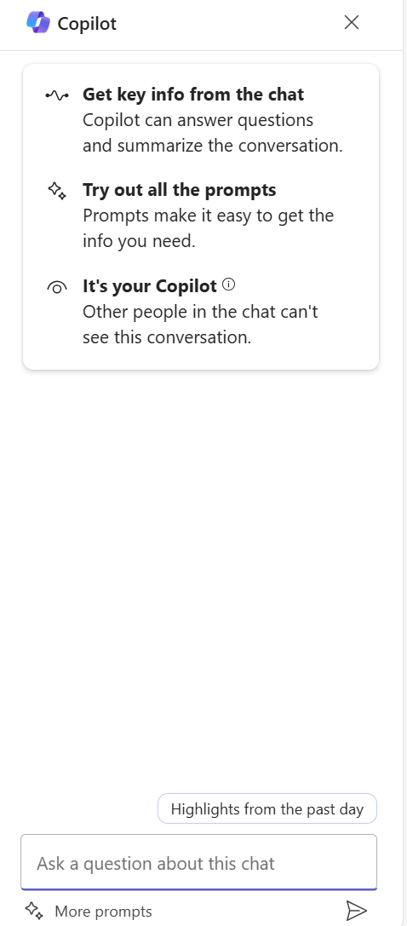
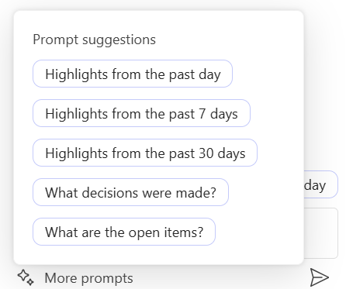
Getting started
Open the chat panel
You must be in a 1:1 or group chat, to access the private Copilot side panel.
Explore Prompt suggestions
Chat Copilot provides suggested prompts for you to use to explore the power of Copilot.

Slide 18
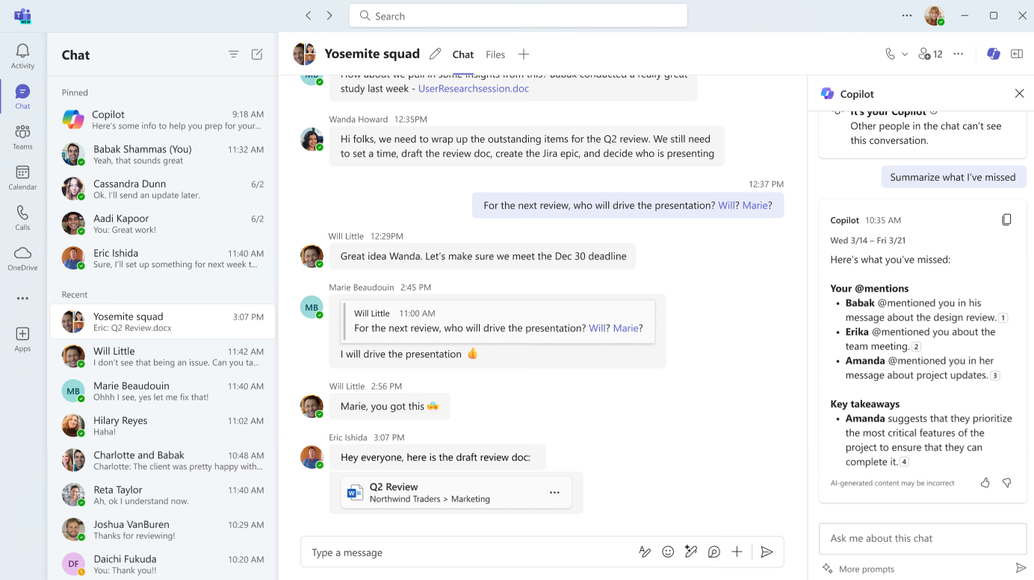
Summarize chat
Currently by default the summarization will go back 30 days. A user can specify a time period if they wish to go back more in the history.

Slide 19
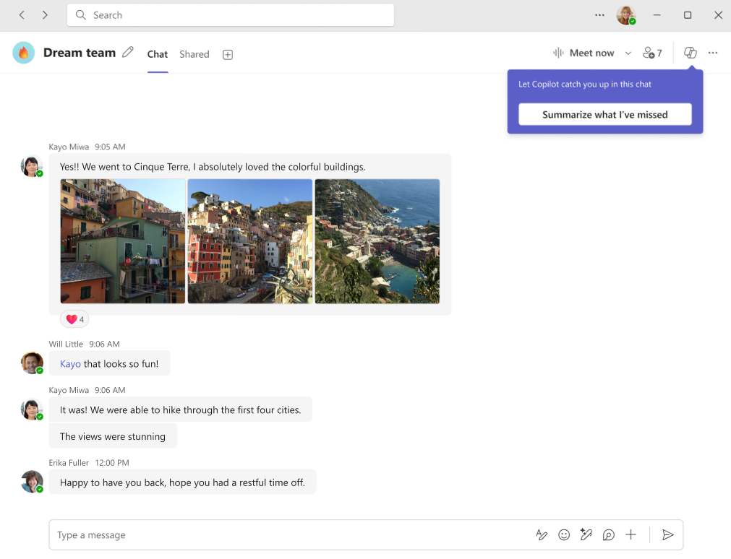
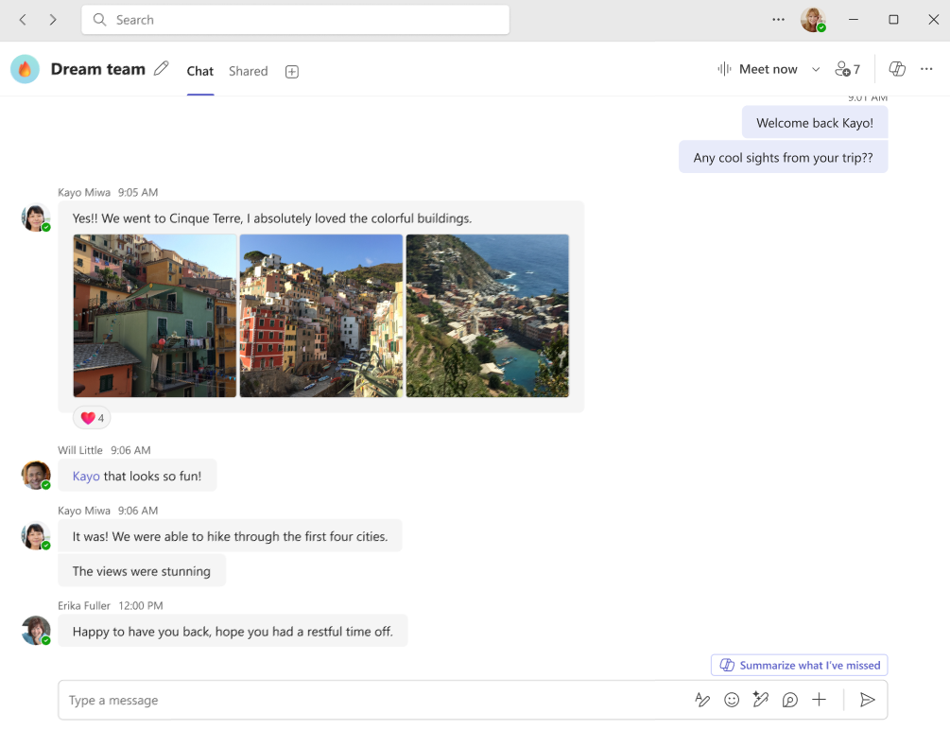
Coachmarks – Smart actions
When users need to catch up on missed messages, we help them navigate to Copilot in chat to quickly catch up.

Slide 20
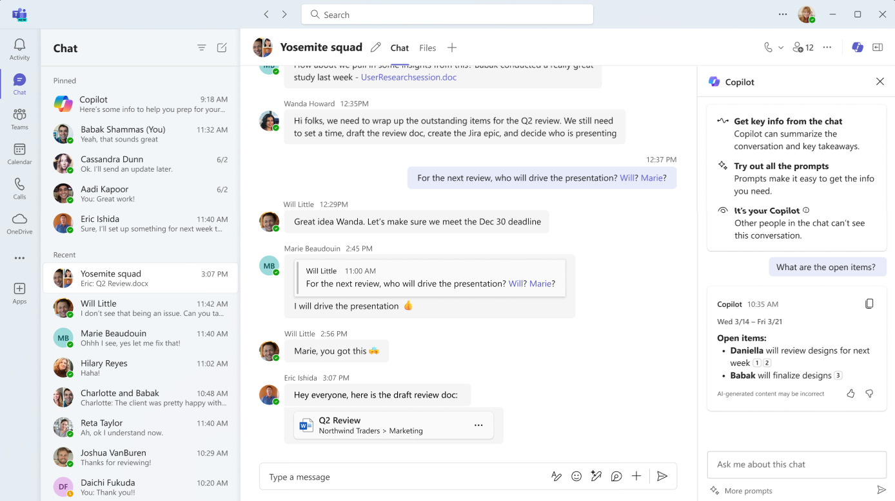
Identify open items and decisions
Users can ask Copilot to identify key decisions and open items in the chat so they can stay on track.

Slide 21
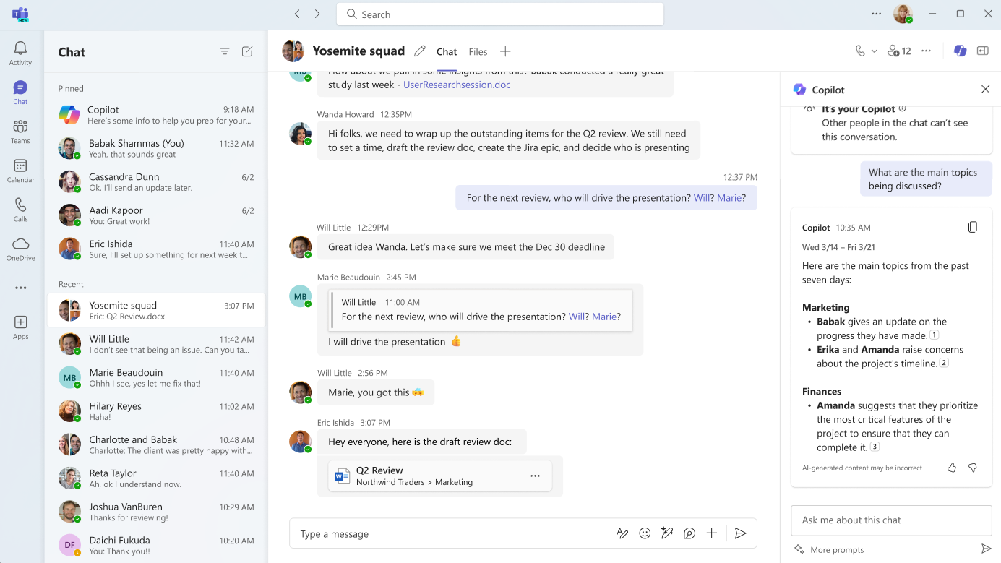
Chat Q&A
To ask about specific content int the chat, you can type a private message to Copilot.

Slide 22
Channels Copilot

Slide 23
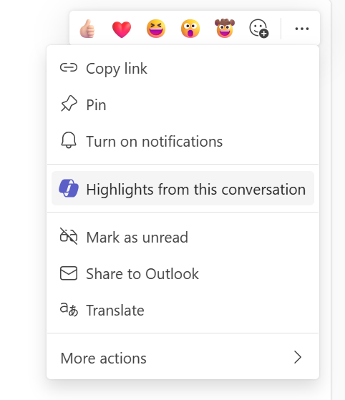
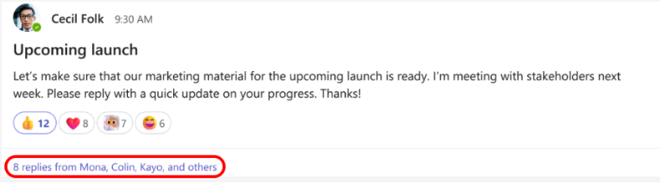
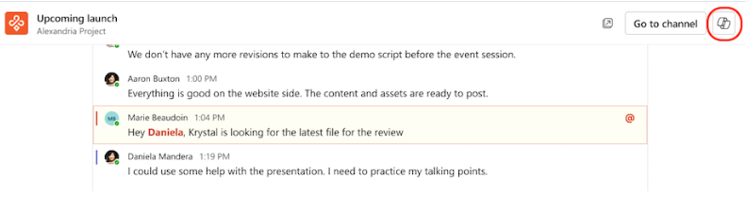
Getting started
We offer two entry points to open Channels Copilot.
Option #1: Navigate to the three dots on the channel post of interest to open Copilot.
Option #2: Within the channel post of interest, click to expand the full conversation and find the Copilot entry point in the upper right-hand corner.

Slide 24
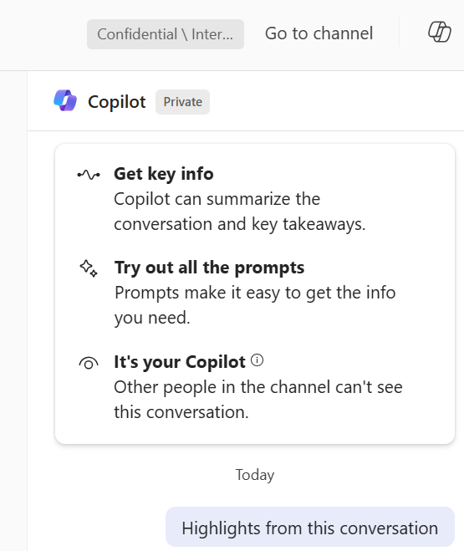
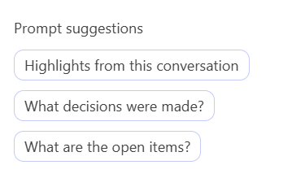
Channels Copilot highlights
Differentiator
Channels Copilot has a button signifying that it is associated with a channel post.
Suggested prompts
Channels Copilot also has suggested prompts for you to explore the power of Copilot in channels.

Slide 25

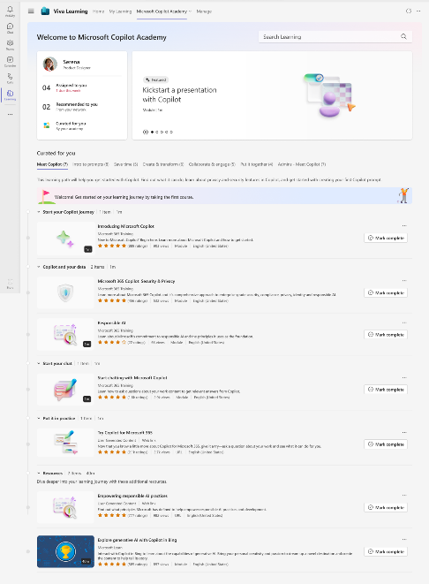
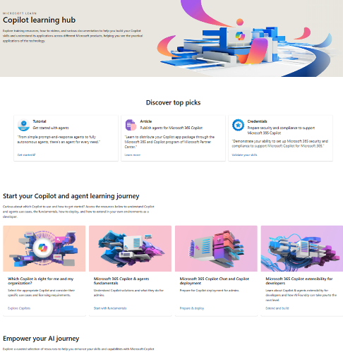
Skilling experiences
Microsoft
Copilot Academy
Available to all Microsoft 365 Copilot customers
Centralized location to help with the basics of Copilot learning and upskilling, pulling the best content from available free Microsoft sources
Structured content in easily consumable learning paths curated by Microsoft experts
Develop your AI interaction skills from your Viva Learning app in Teams or webapp
Microsoft Learn
Free, on-demand training content for skill development
Step-by-step exercises guiding learners through common Copilot prompts and use cases
Downloadable assets for customization available at adoption.microsoft.com/copilot
Notes:
This slide shows the top skilling experiences for Microsoft 365 Copilot:
Copilot Academy is a free training tool built on Viva Learning and available directly within your flow of work for all types of users. It is a centralized location which pulls in the best Copilot learning content into structured, consumable learning paths curated by Microsoft experts.
Microsoft Learn is another free web resource for self-paced, on-demand training content and step-by-step exercises for users. The training content here is skewed towards more technical audiences.

