Slide 1
Get started with Microsoft 365 Copilot in PowerPoint
Practical examples and how-tos for licensed Microsoft 365 Copilot users
September 2025

Slide 2
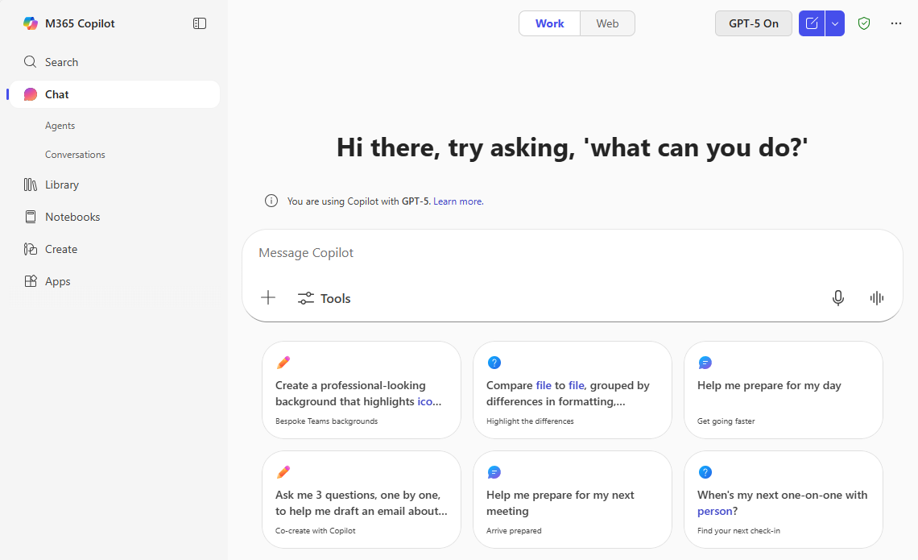
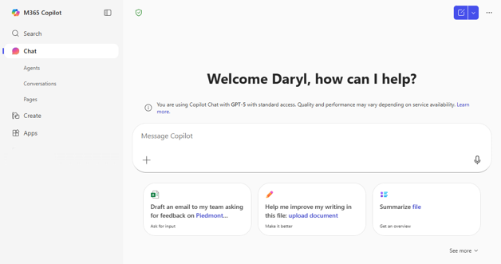
Spot the differences –
M365 Copilot app UI
1
2
UI for licensed Microsoft 365 Copilot users
1
Licensed users have the option so select Work and have Copilot use work data. Unpaid users do not have this option and are limited to responses from the Web or information build into the AI model.
2
Licensed users have access to Notebooks which provide agent functionality to sets of content that teams can edit.
UI for people using capabilities included with Microsoft 365

Slide 3

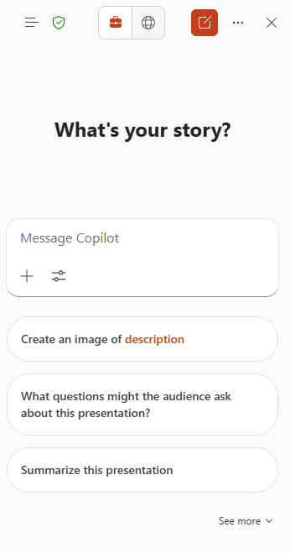
Copilot Chat in PowerPoint overview
With Copilot Chat in PowerPoint, you gain a range of capabilities that make creating, refining presentations faster with more impact, and understanding presentations more intuitive.
Ask questions about your presentation
Summarize slides to capture the main points
Generate relevant images to enhance your visual storytelling.
Here are some ways that you can use Copilot Chat in PowerPoint
“What are some potential questions that I might be asked by the audience who I present this to?”
“Generate an image to use in my presentation.”
“Help me re-write the bullets on this slide.”​​​​​​​
“Create speaker notes for this slide. Write them in bullets and be sure to add context on our differentiation with this strategy document.”
Notes:
Today we’re going to walk through the new look and feel of Copilot in PowerPoint. What Microsoft did is bring the Copilot Chat interface you are used to using in the Copilot app and Edge browser into the apps for a consistent experience. As a licensed users you can still work with Copilot right in the document, but now you can also search for information across your Microsoft data and the web.

Slide 4

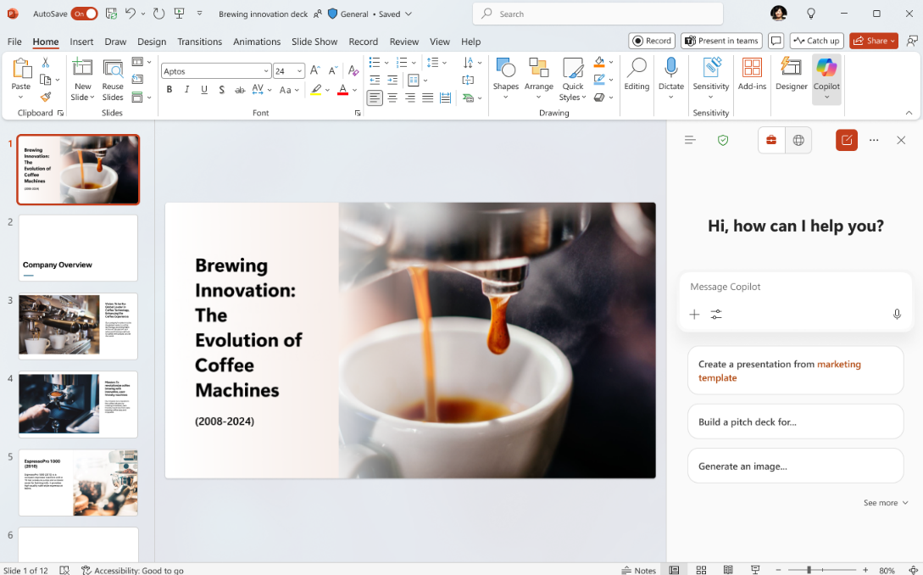



Starting a Copilot Chat in PowerPoint
Enterprise data protection
shield – indicates your data is protected
Work/Web – Choose whether you want Copilot to base responses on your Work data or use the web
Navigation panel
Access agents and conversation history
Copilot
Open Copilot Chat from the ribbon
Start a new chat
More options – feedback and controls options
Close Copilot Chat
Prompt Box
Start your chat here
Add content
Add files and images to the chat
Sample prompts
Suggested prompts that are tailored to your document with option to expand and see more
Access tools
Access agents in your chat
Start dictation
Interact with Copilot using your voice
Notes:
Open Copilot Chat from the ribbon—look for the Copilot icon.
Once you have the Chat window open you’ll see there are a lot of options packed into a small space. But luckily the UI is consistent across all of your apps so you’ll only need to learn it once.
The navigation panel lets you access agents and your conversation history. If you want to continue an old chat or reference information Copilot previously provided you can find that here. When you access an agent you will leave Copilot Chat and interact with that agent. You’ll need to go back to the Navigation panel if you want to use Copilot Chat again.
The enterprise data protection shield means your data is secure. You can start a new chat, access more options (like feedback and controls), and close the chat when done. When you start a new chat you have the option to start a temporary chat that won’t be saved in your conversation history.
The prompt box is where you start your conversation—add content, files, or images to enrich your chat. You can also access specialized agents like Designer and use voice dictation.
Sample prompts are tailored to your document, with options to expand and see more.

Slide 5
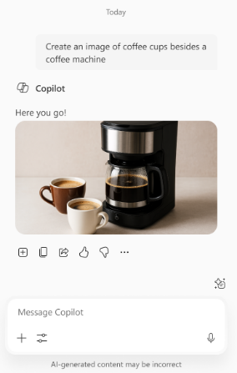
Copilot Chat in PowerPoint response
Add to doc
Insert the response into your document
Copy response
Copy the response to the clipboard to paste in another location
Share prompt and copy with response
Create a link for the prompt in Copilot Chat. Copies the prompt and response with the link to provide context
I like something
Provide positive feedback to your admin and Microsoft
Prompt response
See the response here with references to files or web sites used
I don’t like something
Provide positive feedback to your admin and Microsoft
More options
Options to copy the response to a new document, have the response read aloud, or schedule the prompt for later
Prompt Box
Continue your chat here
Notes:
When you ask a question, Copilot will create a detailed response with references to files or websites used.
You can ask follow-up questions in the prompt box.
Insert responses directly into your document, copy them to the clipboard, or share them with others.
Use the feedback buttons to let Microsoft know what works well or what could be improved.

Slide 6



My Chat pane doesn’t look like the picture
We are squeezing a lot of capabilities into a small space so you may notice the chat pane is highly dynamic depending on its width. Here is what you may experience
Navigation panel
Chat title
Full Work/Web
New chat with temporary option
More options
Full width
Remove chat title
Enterprise data protection shield
Close chat
Move the Enterprise Data Protection shield next to Navigation panel icon
Condensed Work/Web to icons
Move temporary chat option to more options
Min width
Notes:
With more space there is an opportunity to include more information in the Chat options bar. This slide will help make it clear when and where items appear so that you can always find the UI elements you need.
Note that the chat title will only appear if you have already entered a prompt in the chat session.
You’ll notice that the work/web option can show up as words or as icons.
The other main change is that the way to create a temporary chat changes from a dropdown on the new chat button to a selection under More Options.

Slide 7
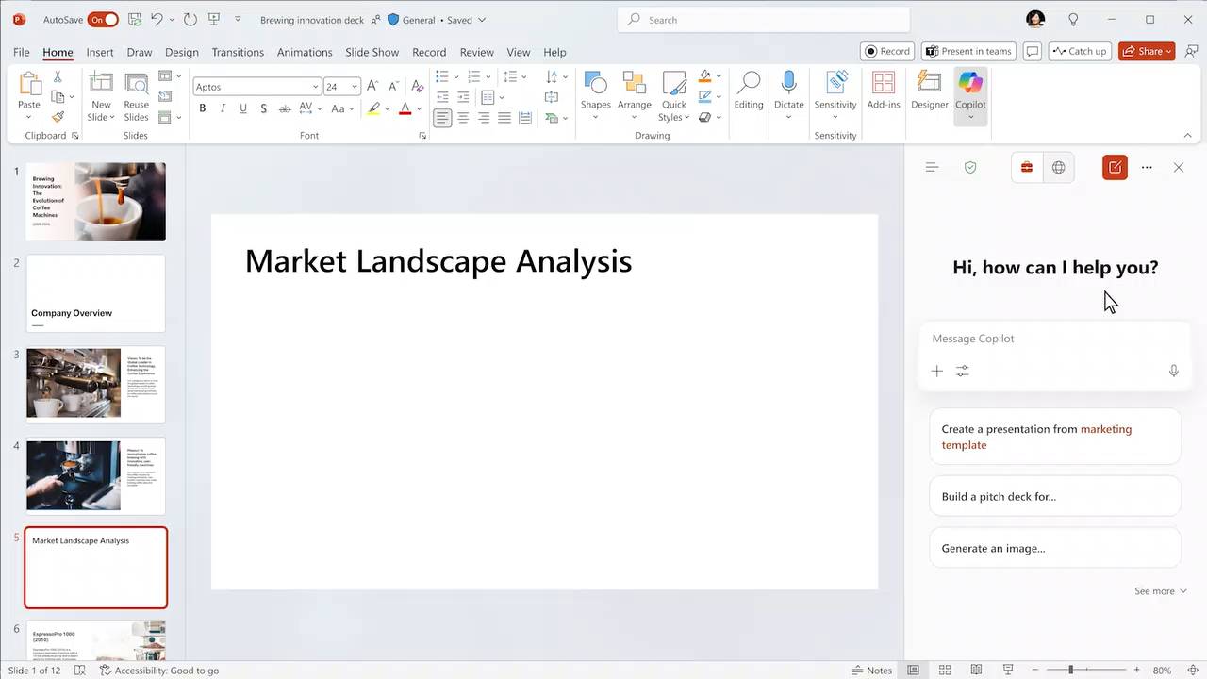
PPT demo – create a slide based on a file

Slide 8
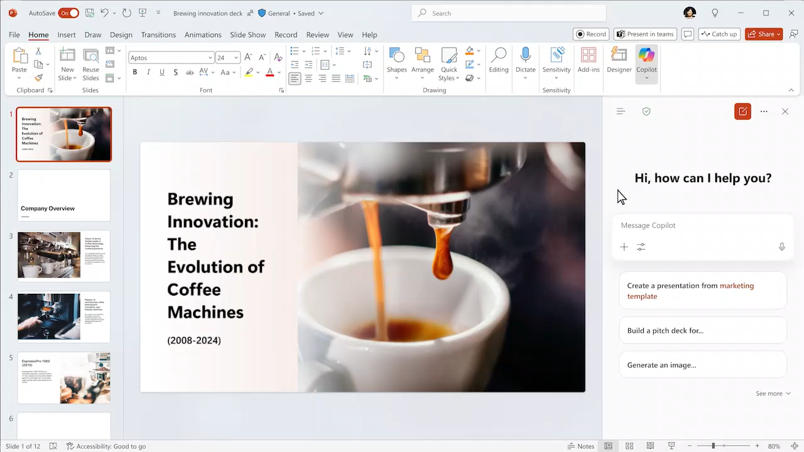
PPT demo – create an image

Slide 9

PPT demo – reference another file

Slide 10
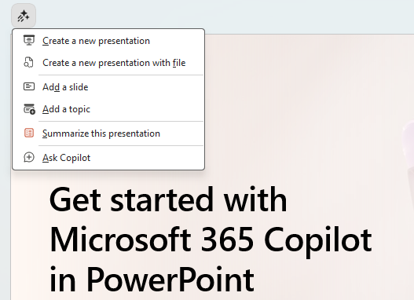
Copilot in-app skills for PowerPoint
Access Copilot App Skills from any slide
Apps Skills use AI to help you work in your presentation. Create a new presentation from a description or a file, add slides or topics, and create a summary.
Notes:
PowerPoint has built-in skills that you can access from each slide to make it easy to perform common tasks. Just click on the Copilot icon and select a task.

Slide 11
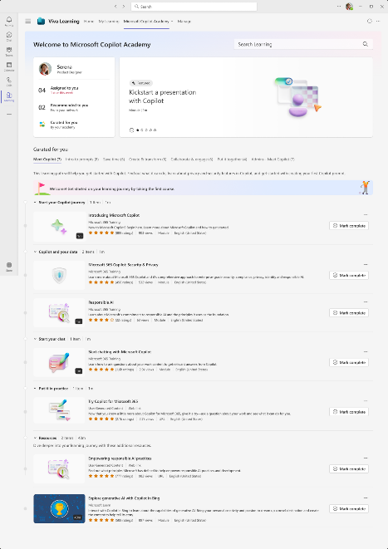
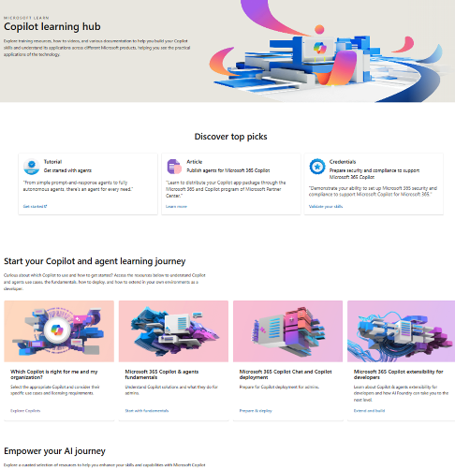
Skilling experiences
Microsoft
Copilot Academy
Available to all Microsoft 365 Copilot customers
Centralized location to help with the basics of Copilot learning and upskilling, pulling the best content from available free Microsoft sources
Structured content in easily consumable learning paths curated
by Microsoft experts
Develop your AI interaction skills from your Viva Learning app
in Teams or webapp
Microsoft Learn
Free, on-demand training content
for skill development
Step-by-step exercises guiding learners through common Copilot prompts and use cases
Downloadable assets for customization available at adoption.microsoft.com/copilot
Notes:
This slide shows the top skilling experiences for Microsoft 365 Copilot:
Copilot Academy is a free training tool built on Viva Learning and available directly within your flow of work for all types of users. It is a centralized location which pulls in the best Copilot learning content into structured, consumable learning paths curated by Microsoft experts.
Microsoft Learn is another free web resource for self-paced, on-demand training content and step-by-step exercises for users. The training content here is skewed towards more technical audiences.

